Slide 1
Machine Learning

Slide 2
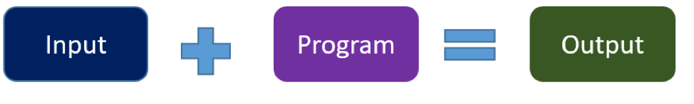
Traditional Programming
Traditional programming is a manual process—meaning a person (programmer) creates the program.
For example, we can write traditional computer program for activity recognition (walking, running, or biking) from person's speed (data).

Slide 3
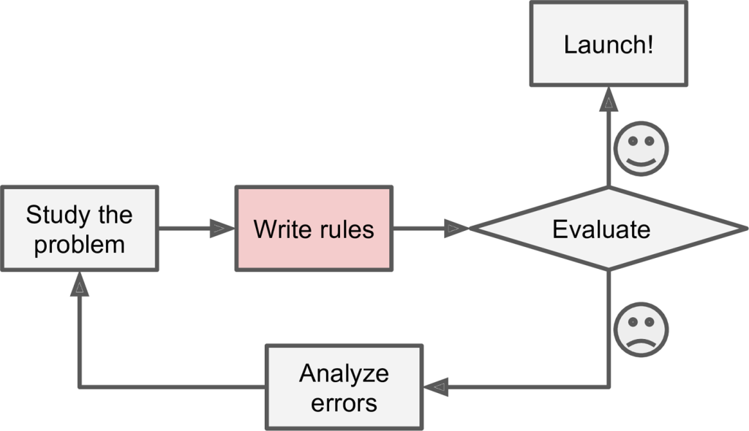
Traditional Approach

Slide 4
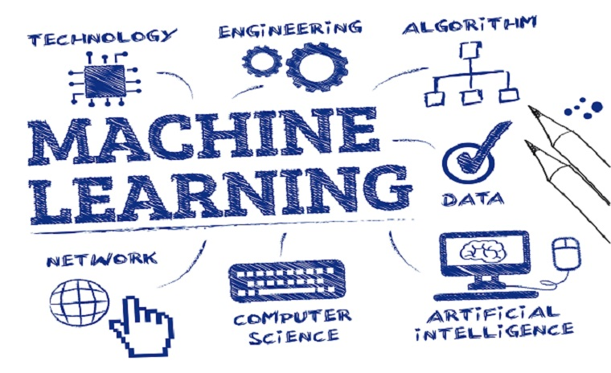
What is Machine Learning
an umbrella of a specific set of algorithms that all have one specific purpose to learn to detect certain patterns from data.
The primary aim is to allow the computers learn automatically without human intervention or assistance and adjust actions accordingly.

Slide 5

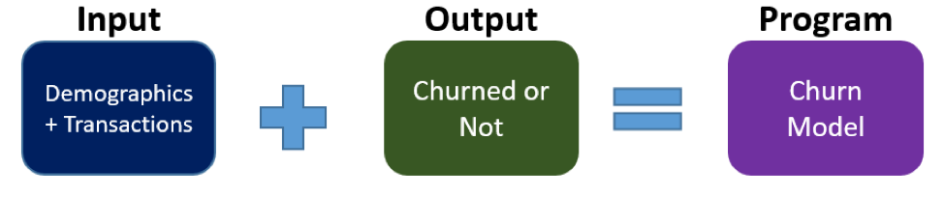
How ML Works

Slide 6
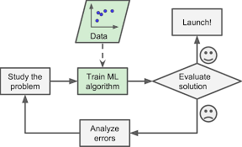
ML Approach

Slide 7
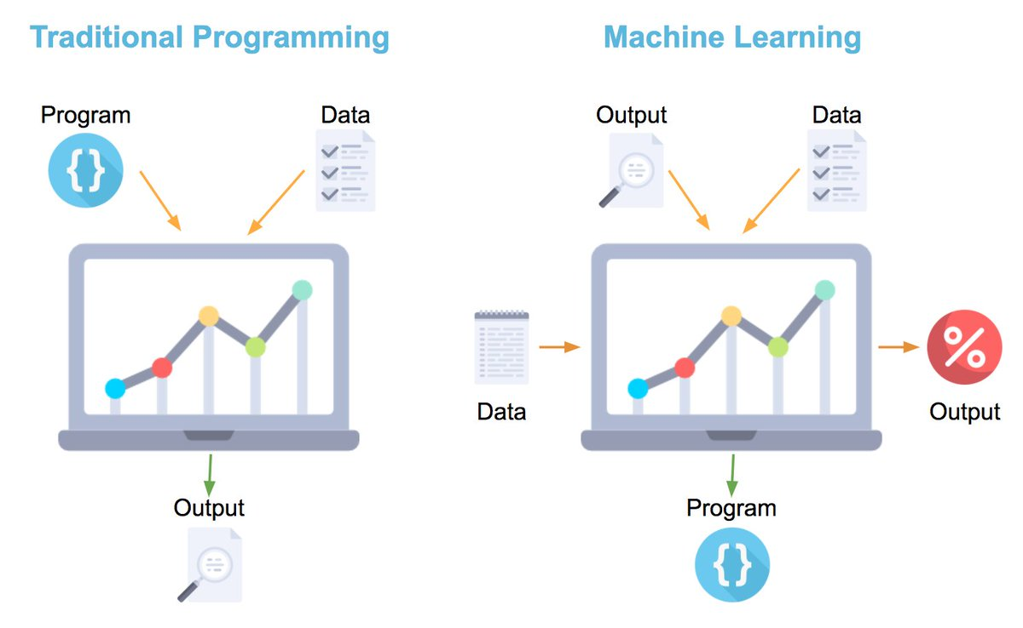
Difference between TP and ML

Slide 8
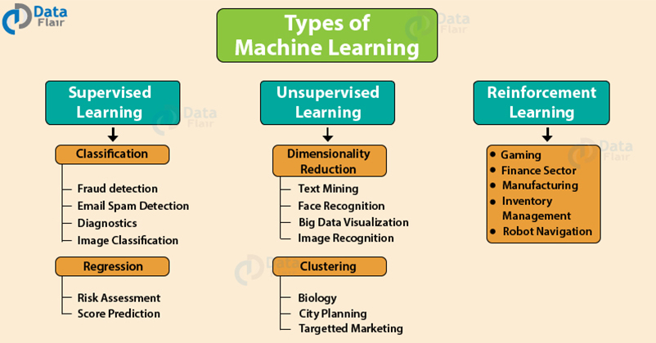
Types of Machine Learning

Slide 9
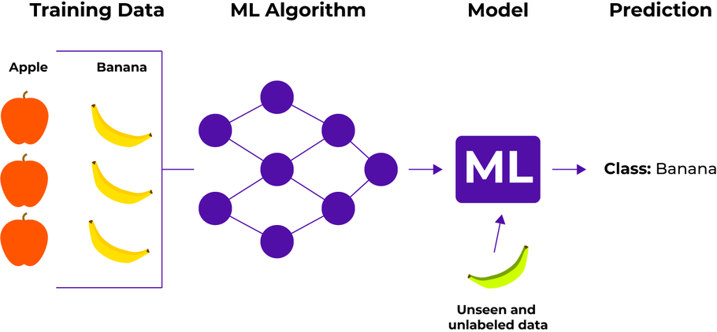
Supervised Learning
A supervised learning algorithm takes a known set of data (input) and known responses to the data (output) and trains a model to generate reasonable predictions for the response to new data.

Slide 10
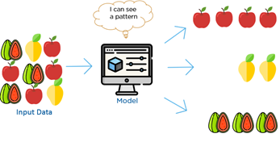
Unsupervised Learning
Unsupervised learning is a type of machine learning that Differentiate input data according their similar look, size, color etc.

Slide 11
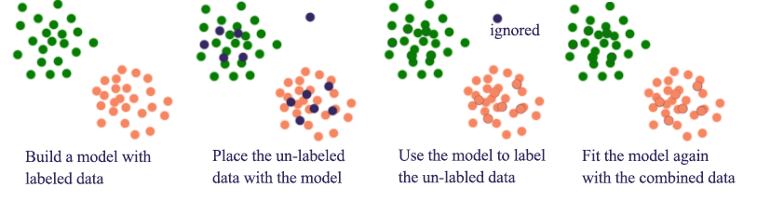
Semi-supervised Learning
Semi-supervised Learning is a combination of the supervised learning and unsupervised learning.

Slide 12
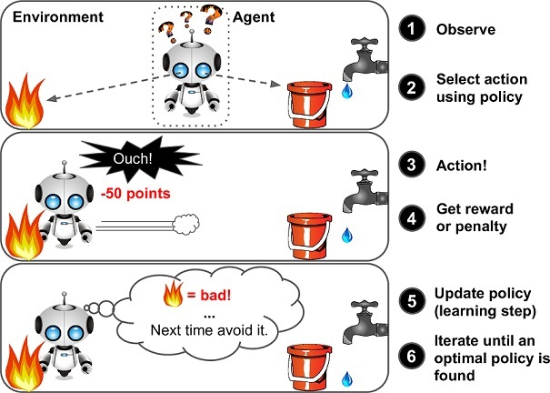
Reinforcement Learning
Reinforcement learning is a very different beast.
It can observe the environment, select and perform action, and get rewards in return. It must then learn by itself what is the best strategy to get the most reward over time.

